Slide 1


Cilium & eBPF: Component Overview
Cilium and eBPF are powerful tools for networking, security, and observability in cloud-native environments.
by Dr Vivek Yoganand PhD

Slide 2
What is Cilium?
Cilium is a CNI (Container Network Interface) plugin for Kubernetes that uses eBPF to provide networking, security, and observability for container workloads. Leverages eBPF (extended Berkeley Packet Filter) technology to provide high performance, advanced security features, and deep network visibility; well-suited for large, complex clusters with demanding security requirement
Key Components
├── Cilium Agent (runs on each node)
├── Cilium Operator (cluster-wide component)
├── Hubble (observability platform)
└── eBPF programs (loaded into kernel)

Slide 3
What is eBPF?
eBPF (extended Berkeley Packet Filter) is a revolutionary technology that allows programs to run in the Linux kernel without changing kernel source code or loading kernel modules. Think of it as a "mini-processor" inside the kernel.
Key Features of eBPF
Programmability at kernel level
High-Performance Networking
Security Monitoring
Observability
Safe Execution through verification

Slide 4
Is Cilium act as Service Mesh?
Yes, Cilium can act as a service mesh and provides similar capabilities to traditional service mesh solutions like Istio, but with some unique advantages due to its eBPF-based architecture. Let me explain how Cilium Service Mesh works
Cilium Service Mesh Features
Traditional Service Mesh Implementation:
Application Pod --> Envoy Sidecar --> Network --> Envoy Sidecar --> Application Pod
Cilium Service Mesh Implementation:
Application Pod --> eBPF --> Network --> eBPF --> Application Pod

Slide 5
Service Mesh
Service Mesh Features
┌─────────────────────────────────────┐
│ Control Plane │
├─────────────────────────────────────┤
│ - Service Discovery │
│ - Configuration Management │
│ - Certificate Management │
│ - Policy Control │
└─────────────────────────────────────┘
▲
│
▼
┌─────────────────────────────────────┐
│ Data Plane │
├─────────────────────────────────────┤
│ - Proxy Sidecars (e.g., Envoy) │
│ - Traffic Management │
│ - Load Balancing │
│ - Security │
└─────────────────────────────────────┘

Slide 6
Cilium Service Mesh
Cilium Service Mesh Features
┌─────────────────────────────────────┐
│ Cilium Control Plane │
├─────────────────────────────────────┤
│ - Cilium Operator │
│ - Kubernetes Integration │
│ - Policy Management │
│ - Service Discovery │
└─────────────────────────────────────┘
▲
│
▼
┌─────────────────────────────────────┐
│ eBPF Data Plane │
├─────────────────────────────────────┤
│ - Direct Kernel Integration │
│ - No Sidecars Needed │
│ - High-Performance Networking │
│ - Security Enforcement │
└─────────────────────────────────────┘

Slide 7
How Cilium Works with Kubernetes
Network Connectivity:
Pod A → eBPF hooks → Kernel networking → eBPF hooks → Pod B
Network Connectivity:
Request → eBPF program → Policy check → Allow/Deny → Destination

Slide 8
Network Flow Processing
Ingress Path
Egress Path:
1. Packet arrives at network interface
2. XDP/eBPF program processes packet
3. Routing decision made
4. Network policies applied
5. Packet delivered to pod
1. Pod sends packet
2. eBPF program intercepts
3. Policy verification
4. Network translation (if needed)
5. Packet forwarded

Slide 9
Cilium Agent
Node Agent
Manages eBPF
Runs on each node. Accepts configurations via Kubernetes or APIs.
Manages eBPF programs for network access control.

Slide 10
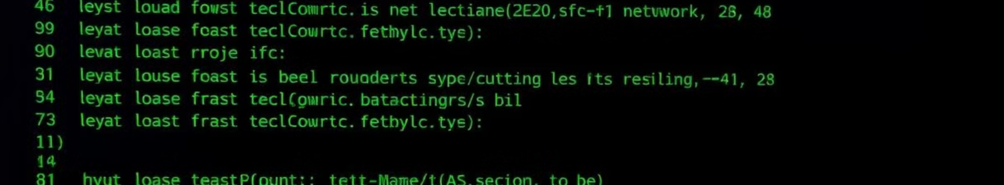
Cilium CLI & CNI
CLI Client
CNI Plugin
Inspects the state and status of the local agent.
Invoked by Kubernetes to configure networking for pods.

Slide 11

Cilium Operator
1
Cluster Management
2
IPAM
Handles cluster-wide duties.
Manages IP Address Management.
3
Kvstore Heartbeat
Updates the kvstore heartbeat key.

Slide 12




Hubble Components
Server
Relay
CLI
Retrieves eBPF-based visibility from Cilium.
Offers cluster-wide visibility.
Retrieves flow events.

Slide 13


Hubble GUI
Graphical UI
Provides a graphical service dependency and connectivity map.

Slide 14



eBPF in Cilium
Extended
2
Now supports data structures and actions.
Filtering
1
Originally for network packet filtering.
Verifier
3
Ensures program safety.

Slide 15
Data Store Options
Kubernetes CRDs
Key-Value Store
Default choice for storing data and propagating state.
Optionally used for improved scalability.

Slide 16
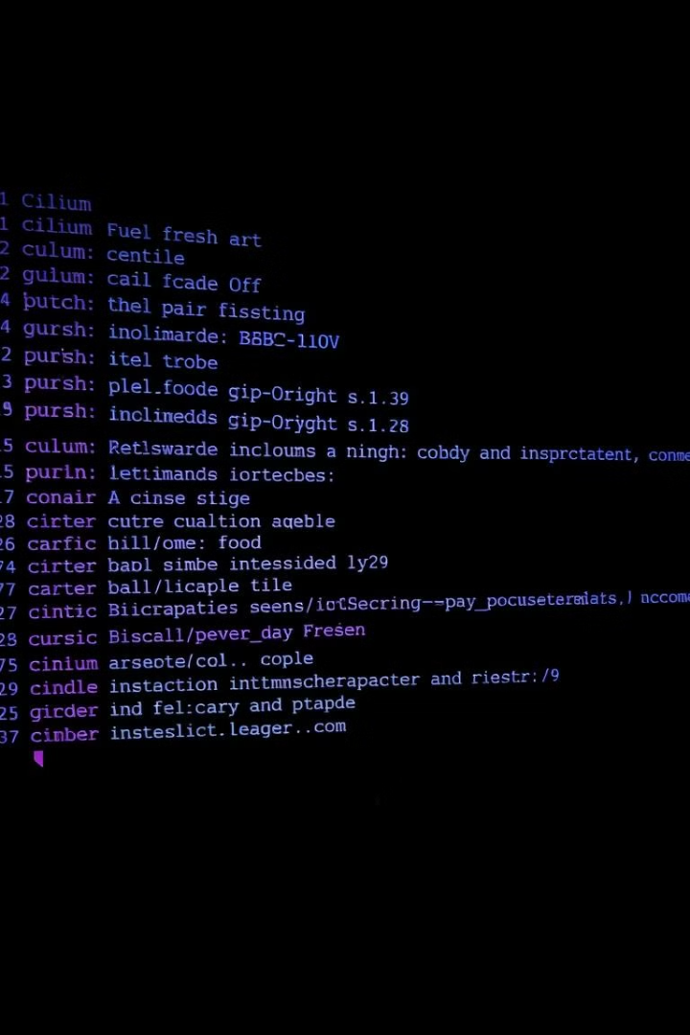
Cilium Command Cheatsheet
Cilium is controlled via an easy command-line interface. This CLI is a single application that takes subcommands. All commands and subcommands have the option `-h` that will provide information about the options and arguments that the subcommand has.
by Dr Vivek Yoganand PhD

Slide 17
Command Utilities
JSON Output
JSONPath Support
Shell Tab-completion
List commands return a pretty printed list. Use `-o json` for detailed JSON output.
Extract detailed information using JSONPath. Example: `cilium-dbg endpoint list -o jsonpath='{[*].id}'`
Cilium CLI provides tab completion for bash or zsh. Run `source <(cilium completion)` to install.

Slide 18
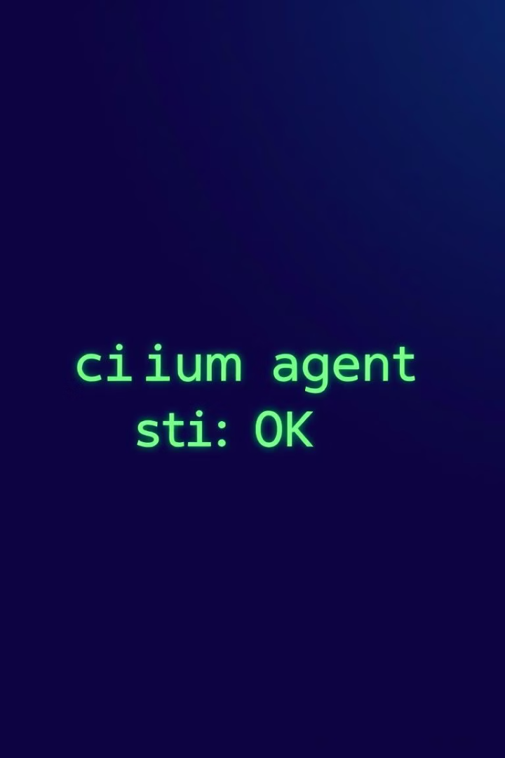
Basic Commands
1
Check Agent Status
2
Detailed Status
l
Use `cilium-dbg status` to check the status of the agent.
Get a detailed status with `cilium-dbg status --all-controllers --all-health`.
3
Agent Configuration
View the current agent configuration with `cilium-dbg config`.

Slide 19




Policy Management
Import Policy
List Policies
Remove Policies
Import a Cilium Network Policy using `cilium-dbg policy import my-policy.json`.
Get a list of all imported policy rules with `cilium-dbg policy get`.
Remove all policies using `cilium-dbg policy delete --all`.

Slide 20
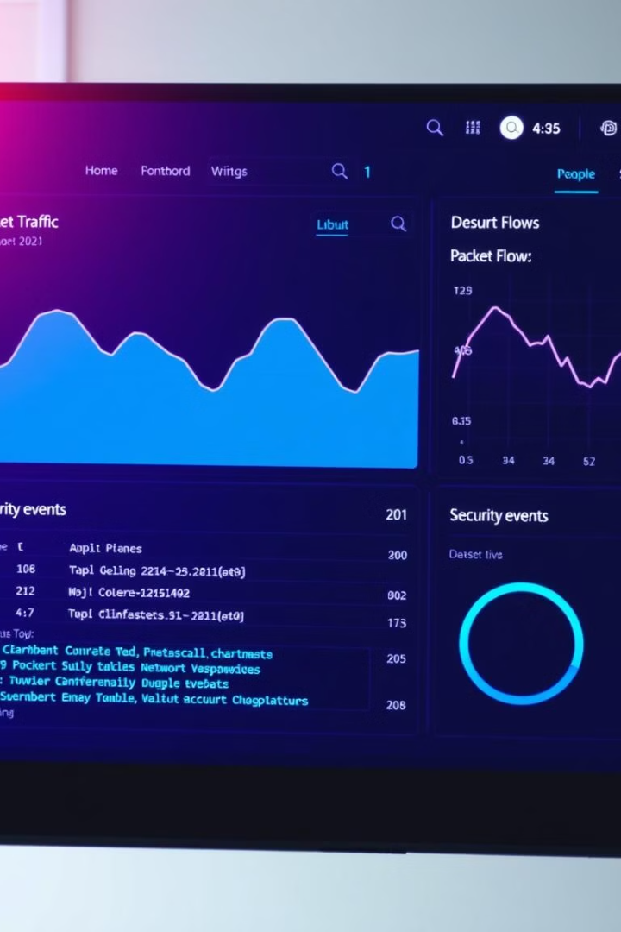


Monitoring Commands
Monitor Datapath
Monitor cilium-dbg datapath notifications with `cilium-dbg monitor`.
Verbose Output
Use `cilium-dbg monitor -v` for verbose output.
Filter Events
Filter events related to an endpoint with `cilium-dbg monitor --related-to=`.

Slide 21
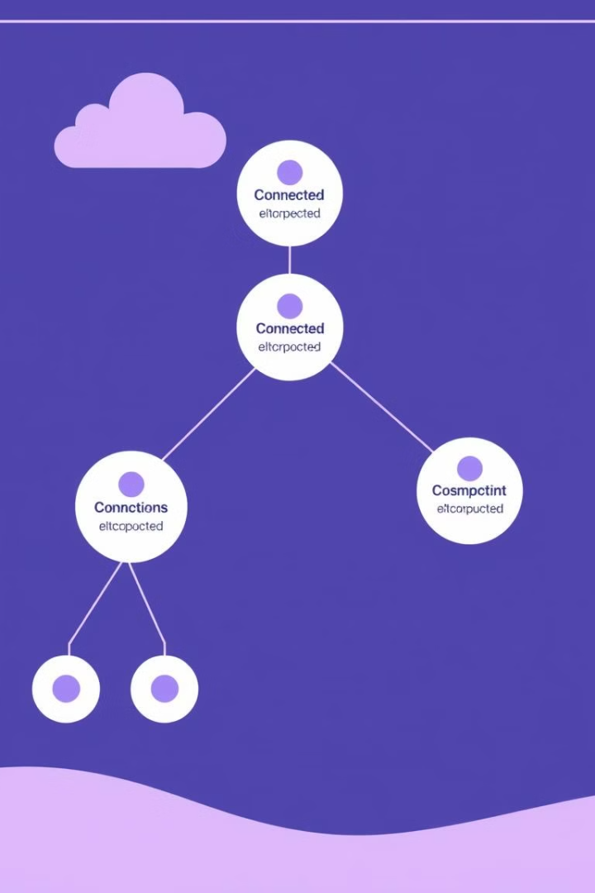
Connectivity & Endpoints
Cluster Connectivity
List Endpoints
Check cluster connectivity with `cilium-health status`.
Get a list of all local endpoints using `cilium-dbg endpoint list`.
Endpoint Details
View detailed endpoint properties with `cilium-dbg endpoint get `.

Slide 22

Loadbalancing & eBPF
List Services
1
Get a list of loadbalancer services with `cilium-dbg service list`.
2
eBPF Tunnel List
List node tunneling mapping information with `cilium-dbg bpf tunnel list`.
Connection Tracking
3
List connection tracking entries with `sudo cilium-dbg bpf ct list global`.

Slide 23
Kubernetes Examples
Cilium Policies
2
Get Kubernetes Cilium Policies with `kubectl get cnp`.
Kubernetes Policies
1
Retrieve Kubernetes Network Policies with `kubectl get netpol`.
Cilium Endpoints
List all endpoints managed by cilium with `kubectl get cep`.
3

Slide 24
Cilium DaemonSet in the kube-system namespace.
Basic Cilium Commands
# Check Cilium status
kubectl -n kube-system exec ds/cilium -- cilium status
# Detailed status with all components
kubectl -n kube-system exec ds/cilium -- cilium status --all-controllers --all-health --all-redirects
# Get current configuration
kubectl -n kube-system exec ds/cilium -- cilium config
# Show version
kubectl -n kube-system exec ds/cilium -- cilium version
# Get debug information
kubectl -n kube-system exec ds/cilium -- cilium debuginfo

Slide 25
Cilium DaemonSet in the kube-system namespace.
Policy Management Commands
# Import network policy
kubectl -n kube-system exec ds/cilium -- cilium policy import my-policy.json
# List all policies
kubectl -n kube-system exec ds/cilium -- cilium policy ge
t# Delete all policies
kubectl -n kube-system exec ds/cilium -- cilium policy delete –all
# Get policy selectors
kubectl -n kube-system exec ds/cilium -- cilium policy selectors

Slide 26
Cilium DaemonSet in the kube-system namespace.
Monitoring Commands
# Basic monitoring
kubectl -n kube-system exec ds/cilium -- cilium monitor
# Verbose monitoring
kubectl -n kube-system exec ds/cilium -- cilium monitor -v
# Extra verbose with packet dissection
kubectl -n kube-system exec ds/cilium -- cilium monitor -v -v
# Filter by endpoint
kubectl -n kube-system exec ds/cilium -- cilium monitor --related-to=<id>

Slide 27
Cilium DaemonSet in the kube-system namespace.
Monitoring Commands
# Monitor L7 traffic
kubectl -n kube-system exec ds/cilium -- cilium monitor -t L7
# Monitor dropped packets
kubectl -n kube-system exec ds/cilium -- cilium monitor --type drop
# Show hex payload
kubectl -n kube-system exec ds/cilium -- cilium monitor -v -v --hex

Slide 28
Cilium DaemonSet in the kube-system namespace.
Endpoint Management
# List endpoints
kubectl -n kube-system exec ds/cilium -- cilium endpoint list
# Get endpoint details
kubectl -n kube-system exec ds/cilium -- cilium endpoint get <id>
# View endpoint logs
kubectl -n kube-system exec ds/cilium -- cilium endpoint log <id>
# Enable endpoint debugging
kubectl -n kube-system exec ds/cilium -- cilium endpoint config <id> Debug=true

Slide 29
Cilium DaemonSet in the kube-system namespace.
Load Balancing Commands
# List services
kubectl -n kube-system exec ds/cilium -- cilium service list
# List BPF load balancer info
kubectl -n kube-system exec ds/cilium -- cilium bpf lb list
# Add new load balancer
kubectl -n kube-system exec ds/cilium -- cilium service update --frontend 127.0.0.1:80 \
--backends 127.0.0.2:90,127.0.0.3:90 \
--id 20

Slide 30
Cilium DaemonSet in the kube-system namespace.
eBPF Commands
# List all the config parameter
kubectl -n kube-system exec ds/cilium – cilium-dbg bpf config list
# List Endpoint list
kubectl -n kube-system exec ds/cilium -- cilium bpf endpoint list
# List the available LB list
kubectl -n kube-system exec ds/cilium -- cilium bpf lb list
# List Node ID
kubectl -n kube-system exec ds/cilium -- cilium bpf nodeid list
# List
kubectl -n kube-system exec ds/cilium -- cilium bpf sha list

Slide 31
Cilium DaemonSet in the kube-system namespace.
Health and Connectivity
# Check cluster connectivity
kubectl -n kube-system exec ds/cilium -- cilium-health status
# Check node status
kubectl -n kube-system exec ds/cilium -- cilium node list
# Monitor cluster health
kubectl -n kube-system exec ds/cilium -- cilium status --all-health

Slide 32
Cilium DaemonSet in the kube-system namespace.
Hubble Commands
# Enable Hubble
kubectl -n kube-system exec ds/cilium -- cilium hubble enable
# Check Hubble status
kubectl -n kube-system exec ds/cilium -- cilium hubble status
# List Hubble metrics
kubectl -n kube-system exec ds/cilium -- cilium hubble metrics list

Slide 33
Cilium DaemonSet in the kube-system namespace.
Service Mesh Commands
# Check service mesh status
kubectl -n kube-system exec ds/cilium -- cilium service list
# View proxy status
kubectl -n kube-system exec ds/cilium -- cilium status | grep Proxy
# List service redirects
kubectl -n kube-system exec ds/cilium -- cilium bpf proxy list

Slide 34
Cilium DaemonSet in the kube-system namespace.
Troubleshooting Commands
# Get debug information
kubectl -n kube-system exec ds/cilium -- cilium debuginfo
# Check policy traces
kubectl -n kube-system exec ds/cilium -- cilium policy trace --src-k8s-pod namespace:pod --dst-k8s-pod namespace:pod
# View metrics
kubectl -n kube-system exec ds/cilium -- cilium metrics list

Slide 35
Cilium DaemonSet in the kube-system namespace.
JSON Output Options
# Get JSON output
kubectl -n kube-system exec ds/cilium -- cilium endpoint list -o json
# Use JSONPath
kubectl -n kube-system exec ds/cilium -- cilium endpoint list -o jsonpath='{[*].id}'

